Slide 1
Sleep Disorder Study Analysis
The effects of Sleep Disorders on Sleep Health

Slide 2
Introduction
The Big Question:
What Factors Affect Sleep Health the Most?

Slide 3
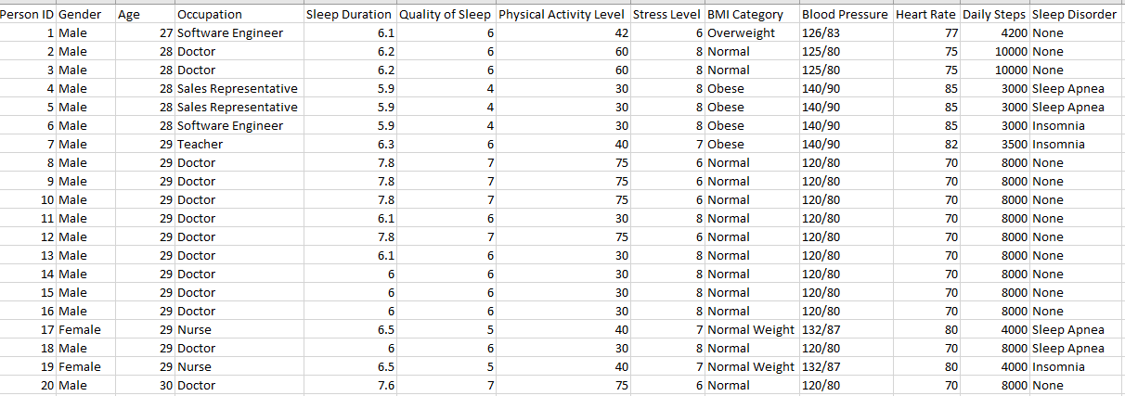
Scenario & Initial Dataset
Dataset Information:
The Sleep Health and Lifestyle Dataset comprises 400 rows and 13 columns, covering a wide range of variables related to sleep and daily habits.

Slide 4
Initial Questions of Interest
Research Questions to Answer:
1. Does occupation affect your sleep?
2. Does lack of sleep cause certain health problems more than others?
3. Does gender and age affect sleep?
4. What affects the quality of sleep the most?

Slide 5
Null Hypotheses
Null Hypothesis based on research questions:
1) A person’s occupation does not affect their sleep health.
2) There is no significant relationship between health factors (Blood pressure, Heart rate, BMI) and patients with sleep disorders. No difference between these factors between patients with a disorder and patients without.
3) Gender and age have no affect on sleep or have connection to sleep disorders.
4) Affects of quality of sleep is not related to Sleep disorders.

Slide 6
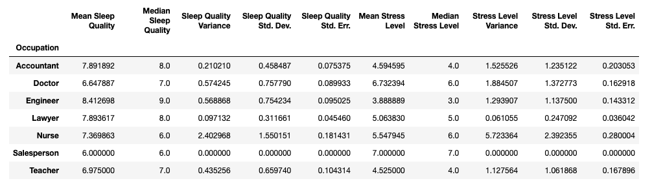
Elisabeth Analysis
Objective: Prove the following Null Hypothesis is wrong.
Null Hypothesis (H0): A person’s occupation does not affect their sleep health.
Alternative Hypothesis (Ha): Sleep health is affected by occupations that are associated with higher stress levels.

Slide 7
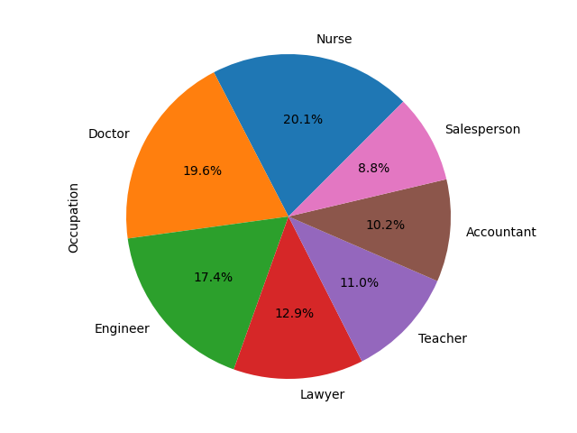
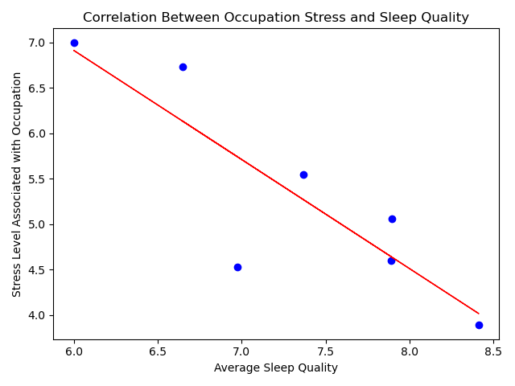
Sleep Health vs. Occupation
Pie Chart: Occupation Distribution
Correlation Plot: Occupation Stress and Sleep Quality
r-value = -0.86 (negative correlation)
Higher occupation stress, lower sleep quality

Slide 8
Elisabeth Conclusion
Sleep quality and occupation stress have a negative correlation (r-value = -0.86). The higher the occupation stress, the lower the sleep quality.
Independent (two-sample) t-test:
Mean of sleep quality grouped by occupation
Mean of stress level grouped by occupation
The p-value is less than 0.05 (p-value = 0.004). Therefore, sleep quality and occupation stress are statistically significant and we can reject the null hypothesis.

Slide 9
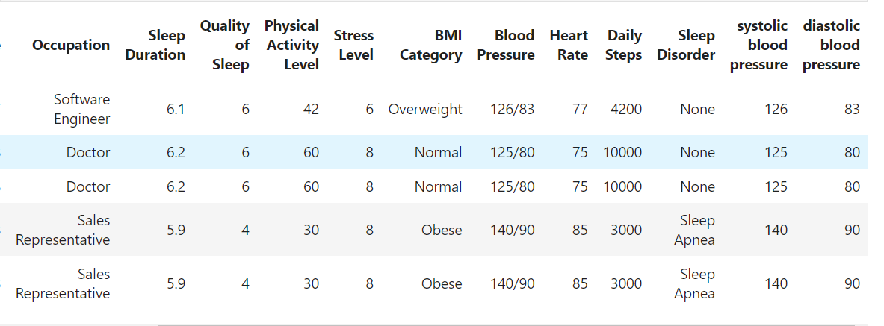
Jessica Analysis
Objective:
Prove the following Null Hypothesis is wrong:
There is no significant relationship between health factors (Blood pressure, Heart rate, BMI) and patients with sleep disorders. No difference between these factors between patients with a disorder and patients without.
Alternative Hypothesis: There is significant cause and effect between health factors (Blood pressure, Heart rate, BMI) and patients with sleep disorders.

Slide 10
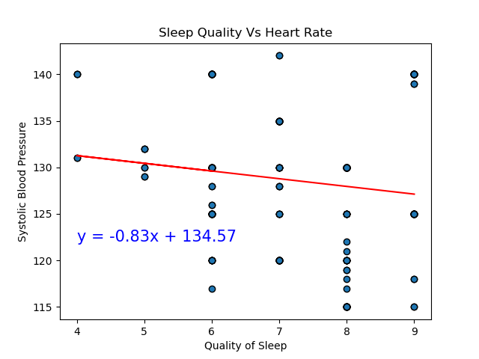
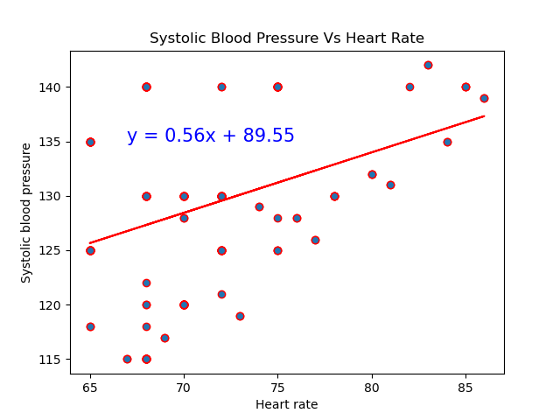
Visuals

Slide 11
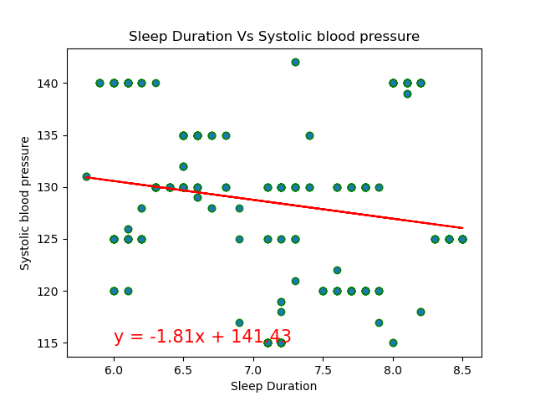
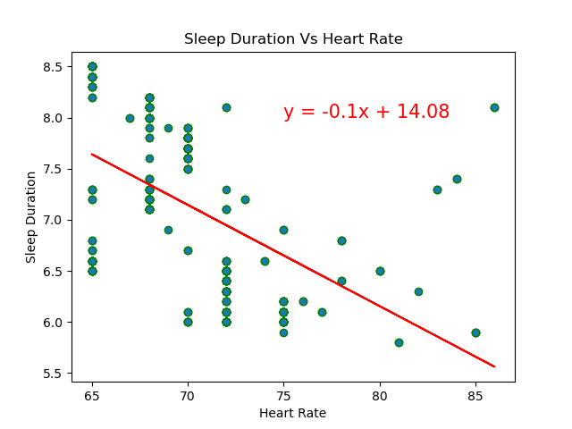
Visuals

Slide 12
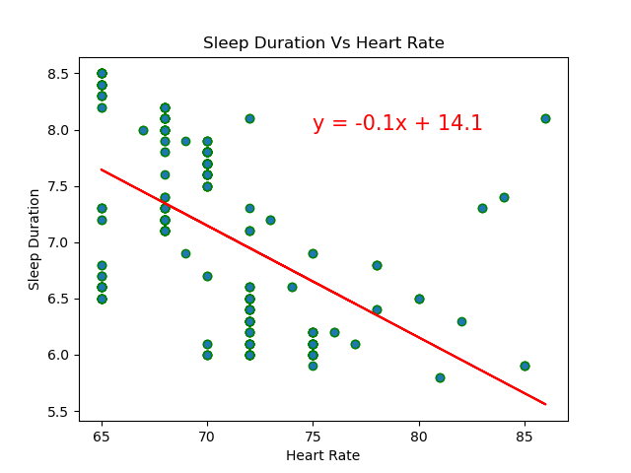
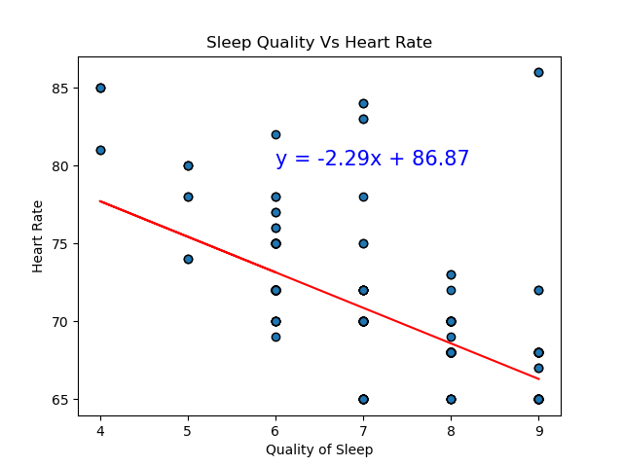
Visuals

Slide 13
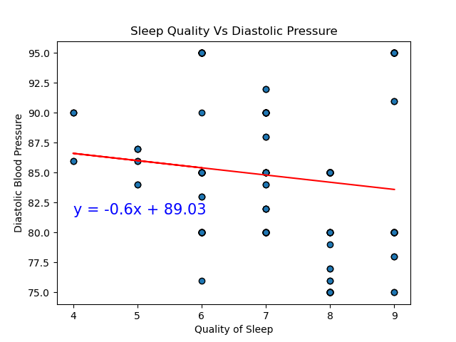
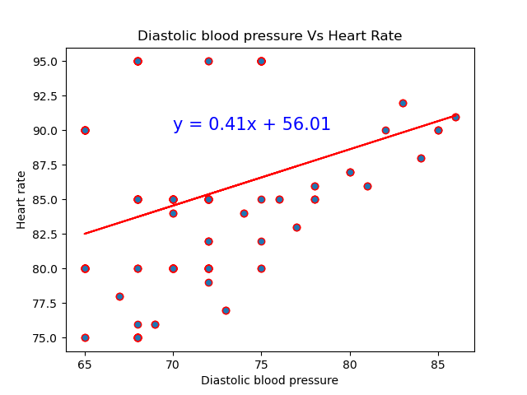
Visuals

Slide 14
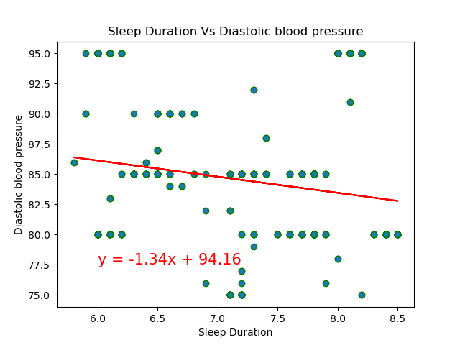
Visuals

Slide 15
Jessica Analysis Continued
Findings from scatterplots:
The diastolic and systolic blood pressures show a similar trend of increasing alongside heartrate, signaling that there is a relationship between increased blood pressure when the heart is actively pumping (systolic) and when the pressure between pumps (diastolic) increases.
There is also an increase in Heart rate with less sleep duration, which is a symptom of Insomnia, and a decrease in reported quality of sleep associated with higher heart rates, a symptom of Sleep Apnea.
Normal control group with no reported sleep disorders has the highest duration and quality of sleep patterns, with overall lower systolic and diastolic blood pressures.

Slide 16
Jessica Analysis Continued
Analysis:
T-testing results between the following groupings on disorders:
Control group - patients without sleep disorders Apnea group - patients with apnea sleep disorder Insomnia group - patients with insomnia sleep disorder
The following results show statistical significance:
Systolic blood pressure, diastolic blood pressure, and heart rate in patients with Apnea sleep disorder
Sleep duration, quality of sleep, systolic and diastolic blood pressure in patients with Insomnia sleep disorder
Therefore, we can reject the null hypothethis that certain health factors are not related and/or symptoms of sleep disorders, specifically Insomnia and Sleep Apnea.

Slide 17
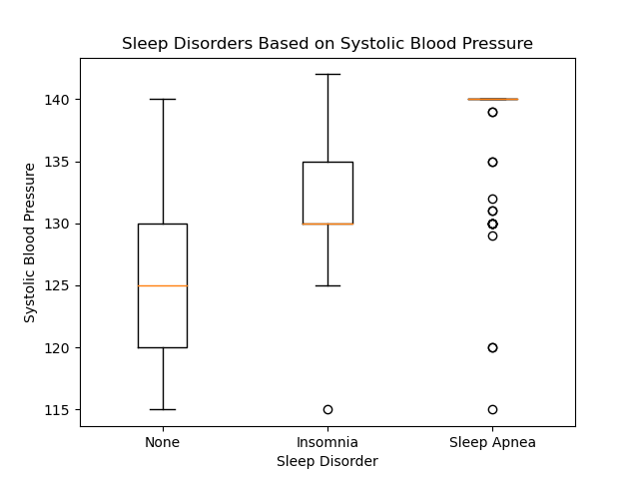
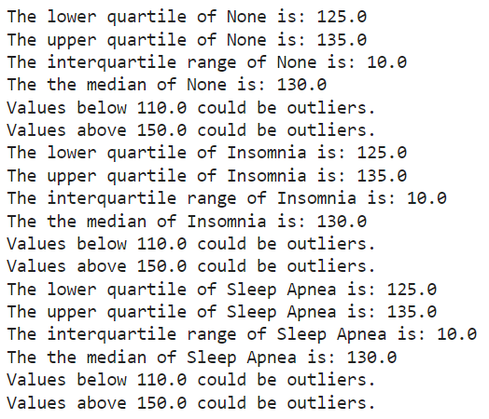
Statistical Visuals

Slide 18
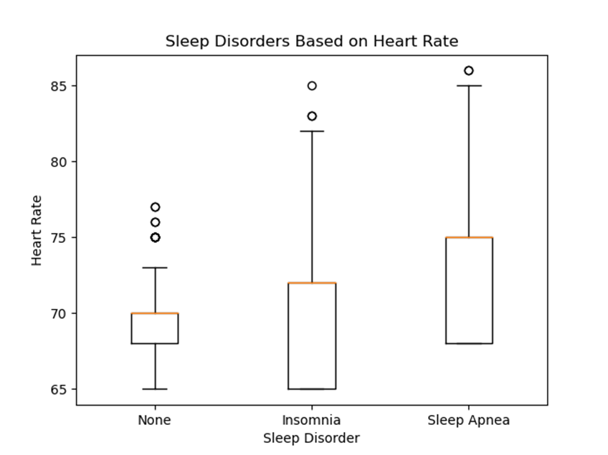
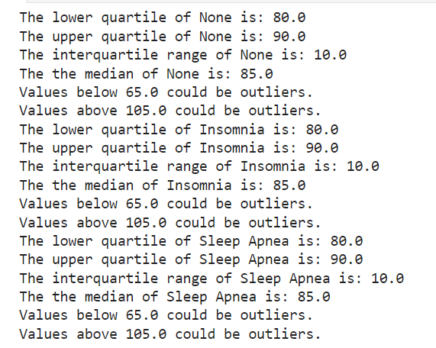
Statistical Visuals

Slide 19
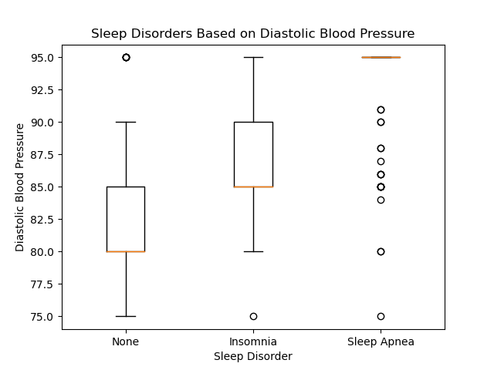
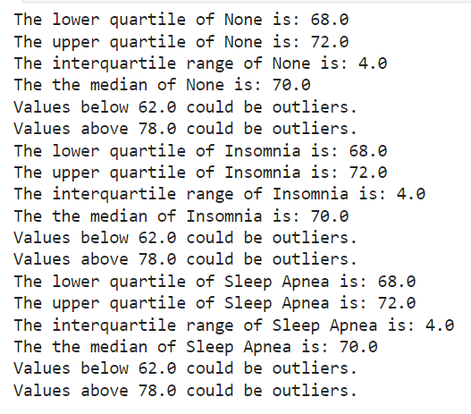
Statistical Visuals

Slide 20
Statistical Conclusions
Conclusion based off Box plot data:
There are more outliers in the Sleep Apnea data regarding diastolic and systolic blood pressure rates. This indicates that Sleep Apnea is significantly outside normal distribution of diastolic and systolic pressure rates compared to the control group of normal patients.
This signals that Sleep Apnea has a high effect on the diastolic, systolic, and overall heart rates of patients by an overall higher rate than patients with no sleep or Insomnia disorders.
It can also be noted that overall heart rate for Sleep Apnea is higher than patients with no sleep disorders, and Insomnia patients are more varied but start in the lower quartile as lower heart rates compared to patients with no disorders.

Slide 21
OC Analysis
Objective:
Prove the following Null Hypothesis is wrong:
Gender and age have no affect on sleep or have connection to sleep disorders.
Alternative Hypothesis: Gender and age have a significant relationship on the proportion of patients who have sleep disorders.

Slide 22
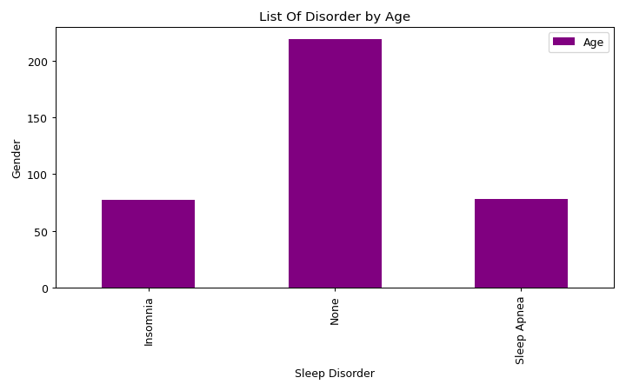
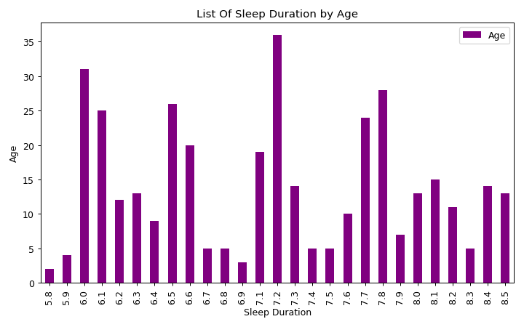
Visuals

Slide 23
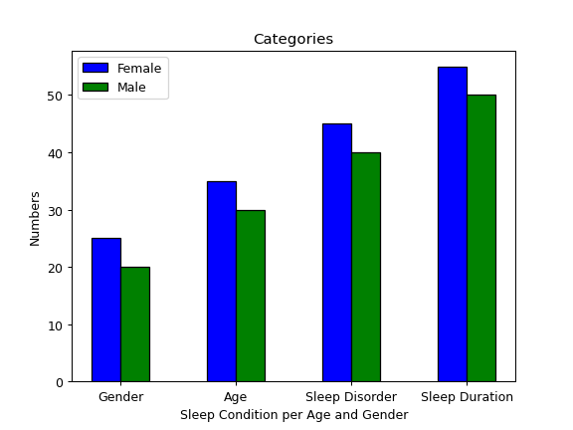
Visuals

Slide 24
OC Conclusion
Alternative Hypothesis: Gender and age have a significant relationship on the proportion of patients who have sleep disorders.
This hypothesis is true.

Slide 25
Abraham Analysis
Objective:
Prove the following Null Hypothesis is wrong:
Affects of quality of sleep is not related to Sleep disorders.
Alternative Hypothesis: Sleep disorders have a significant affect on quality of sleep and are related.

Slide 26
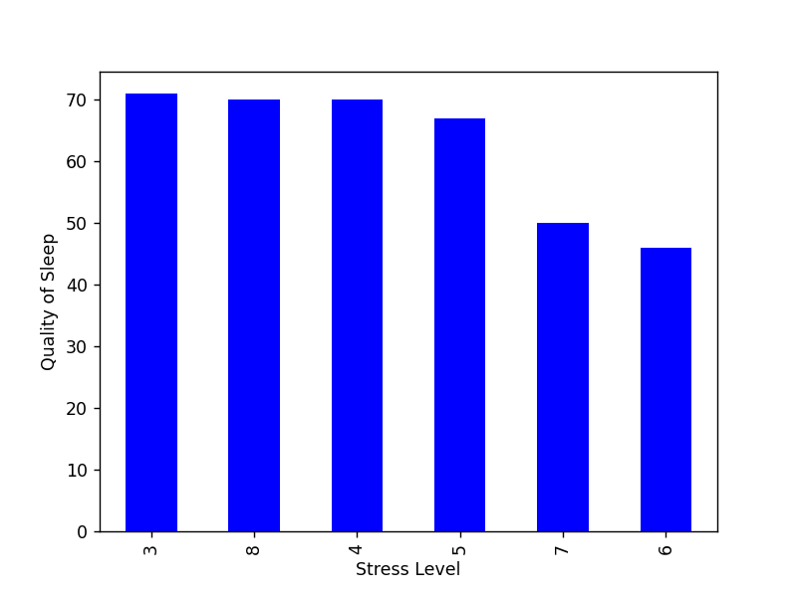
Visuals of Analysis

Slide 27
Abraham Conclusion
Alternative Hypothesis: Sleep disorders have a significant affect on quality of sleep and are related.
This hypothesis is true.

Slide 28
Final Conclusion
Sleep and health factors are related to sleep disorders based on occupation, health of patient, age, gender, and stress levels.

